Slide 1

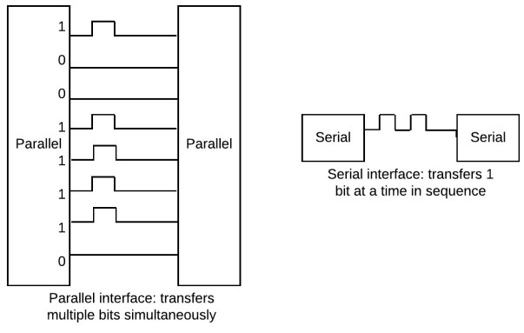

Embedded Communications 1/3
Embedded
Systems II
V.S.
L09
Mr. Nkhumeleni Best
Electrical Engineering
University of Cape Town

Slide 2
Outline of Lecture
Intro to embedded communications
Plan for today:
Quick training (or ‘review’ for most of you probably) regarding “Embedded Communications essentials“
Diving into I2C and a few semaphore-answered questions
Acknowledgement: these slides adapted from ESII 2021 slides by J. Wyngaard.

Slide 3
ES Communications
Comms 1:
Intro: Serial vs Parallel, Synch/Asynch
Comms 2:
I2C & SPI
PWMs & Peripherals
Comms 3:
Timers
RS232 & RS485
Brieﬂy, some other interface protocols
{Brief Introduction to Wireless Communications – if time permits}

Slide 4
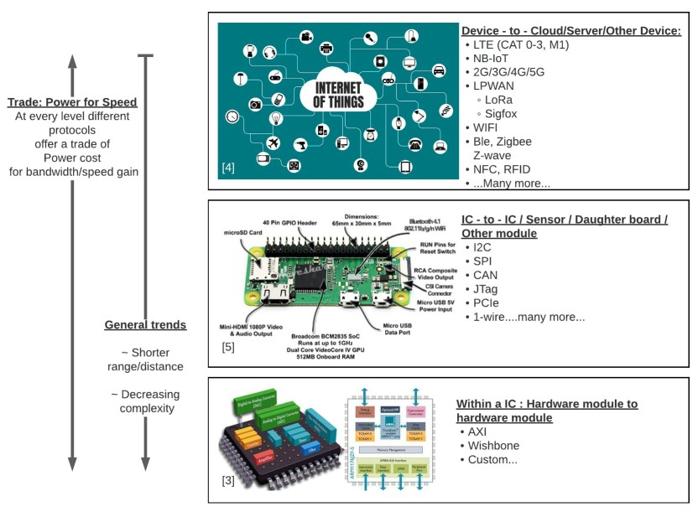
EE Communications
Reminder: Definition of an embedded system:
An ES is a task-specific computer, built into a larger system for the purpose of controlling and monitoring the larger system. (i.e., as per earlier “Brisbane” definition [John Catsoulis])
A microcontroller or microprocessor is just 1 part of that larger system
These micros need to be able to interact with the larger system and the physical world
This is do via either or both wired and wireless interfaces

Slide 5
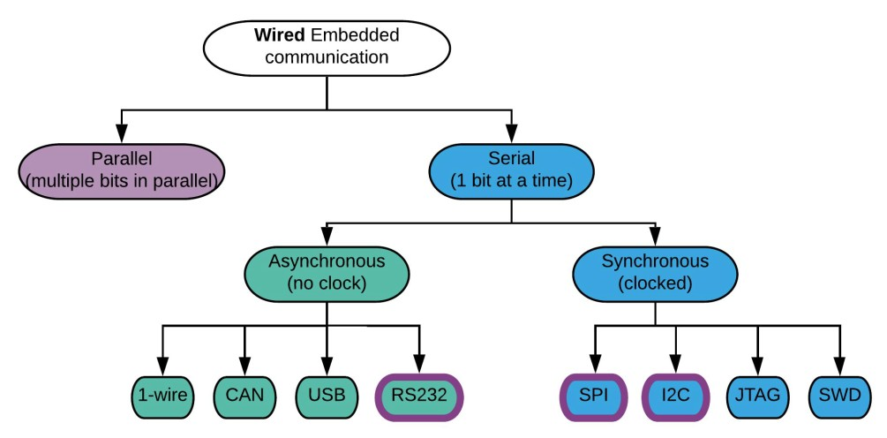
View of a wired ES comms interface
Classification hierarchy of wired communications, formal standards at bottom
In this course we will look at serial standards of:
UART / RS232 (quite similar but wiring and voltages for RS232 are more specific), Serial Peripheral Interface (SPI) and Inter-Integrated Circuit (I2C) protocols

Slide 6
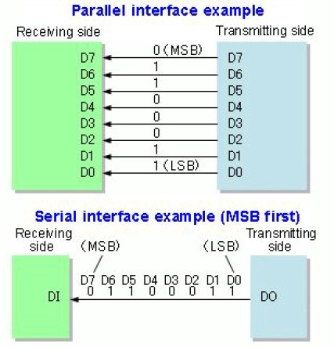
Parallel vs Serial Communications
Illustration of data waveforms in time illustrating that parallel sends multiple bits in one time unit vs. serial sending a bit at a time.
V.S.
Serial vs Parallel Interface structure
Parallel sends multiple bits of data in one go on separate lines; whereas serial sends one bit of data on one line at a time*.
* actually, that is the simplest half-duplex form, serial may be full-duplex and possibly send multiple bits in parallel but not technically a whole word of data in one moment.

Slide 7
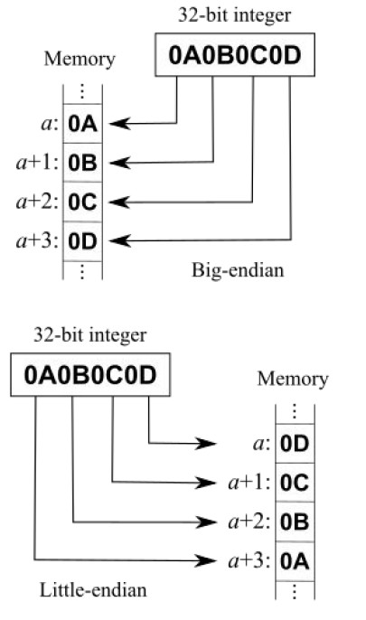
Wired Comms Endianess
Endianess = the order or sequence of bytes of a word of digital data in computer memory (or in a data register).
Big-endian (BE): The most signiﬁcant byte (MSB) of a word is stored at the smallest memory address and the least signiﬁcant byte (LSB) at the largest.
Little-endian (LE): The LSB is stored at the smallest address.
For data transmission:
Big-endian (BE): Means the most signiﬁcant bit is transmitted ﬁrst
Little-endian (LE): Means the most signiﬁcant bit is transmitted last
Notes:
Big END – smallest mem

Slide 8
Endian Examples
Big Endian
Address → Value
0x00 12
0x01 34
0x02 56
0x03 78
(MSB 12 is stored first)
Little Endian
Address → Value
0x00 78
0x01 56
0x02 34
0x03 12
(LSB 78 is stored first)

Slide 9
Endian use cases
Big endian uses
Little endian uses
Big Endian Systems (less common today)
Old Motorola 68k processors (used in early Apple Macs, Amigas, etc.)
SPARC (used in some Sun/Oracle servers)
IBM PowerPC (older Macs, game consoles like PS3, Xbox 360, Wii) — typically big endian
Mainframes (IBM z/Architecture) often use big endian
Networking protocols (TCP/IP, IPv4/IPv6 headers, etc.) always define data in big endian (that’s why we call it network byte order).
Little Endian Systems (most common today)
Intel x86 / x86-64 CPUs (all modern desktops and laptops — Windows, Linux, macOS on Intel chips)
AMD processors (since they’re also x86-64)
RISC-V (default is little endian, though spec allows both)
ARM (most modern) — runs in little endian mode by default on phones, tablets, Raspberry Pi, etc.
👉 Basically, your laptop or phone is almost certainly little endian.

Slide 10
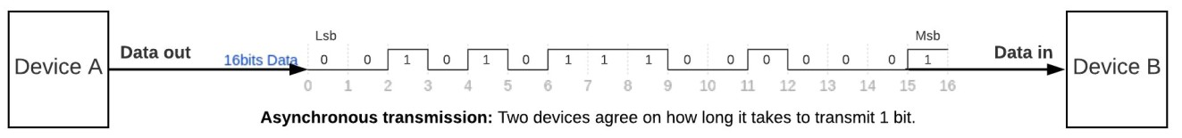
ES Wired Comms: Asynchronous
Asynchronous = un-clocked in electronics terms
i.e. it does not have a separate clock (or clock somehow incorporated) that is used to indicate when actions or decisions occur, e.g. when to check if the signal is high or low.
More formal definition of asynchronous communicatios *:
In telecommunications, asynchronous communication is transmission of data, generally without the use of an external clock signal, where data can be transmitted intermittently rather than in a steady stream. Any timing required to recover data from the communication symbols is encoded within the symbols. Wikipedia
* source: https://en.wikipedia.org/wiki/Asynchronous_communication

Slide 11
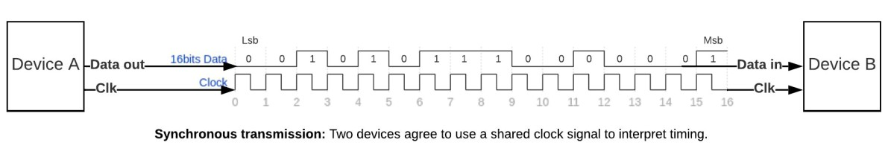
ES Wired Comms: Synchronous
Synchronous = clocked in electronics terms
i.e. it means that a separate clock (or clock somehow incorporated) that is used to indicate when actions or decisions occur.
More formal definition of asynchronous communicatios *:
In telecommunications, synchronous communication requires that the clocks in the transmitting and receiving devices are synchronized – running at the same rate – so the receiver can sample the signal at the same time intervals used by the transmitter. No start or stop bits are required. Wikipedia
* source: https://en.wikipedia.org/wiki/Synchronous_serial_communication

Slide 12
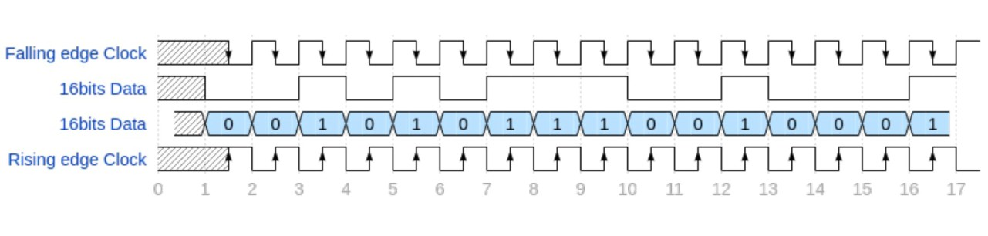
Sampling on an edge?
As mentioned in the definition for synchronous communication, it indicates that a decision or action with regards to the data is actioned on a signal, which is usually a clock edge (it could, for asynchronous, be an agreed time delay).
This image illustrates the difference in rising and falling edge. The 2nd waveform down can be considered the data line coming in to the receiver. The clock signal is shown on the 1st and 4th waveform, the 1st indicating when a falling edge occurs, and the 4th when a rising edge occurs. If you sample the input line on a falling edge you may get different results to sampling the line on a rising edge. This, protocols need to specify if, for a synchronous protocol at least, if the protocol is rising or falling edge triggered*.
* hint: this can make for a convenient test or exam question!

Slide 13
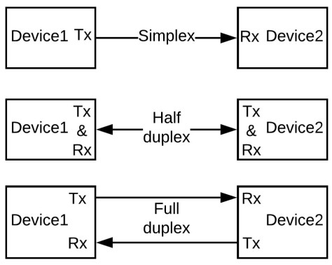
Wired Comms: Simplex vs Duplex
Endianess = the order or sequence of bytes of a word of digital data in computer memory (or in a data register).
Full Duplex: Two devices can communicate simultaneously
Separate data lines for transmit (Tx) and receive (Rx)
Half Duplex: Two devices communicate, one at a time
Transmit and Receive share the same data line
Simplex: Two devices communication in one direction only
Unidirectional communication (ie. only transmit or only receive)

Slide 14
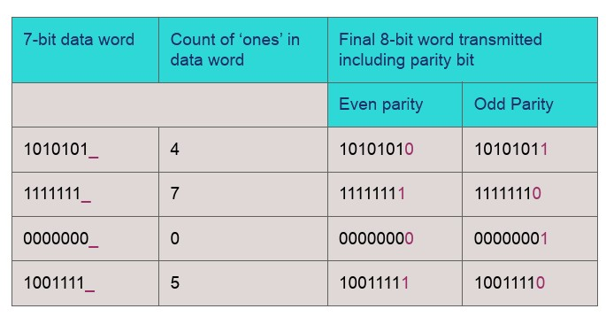
Parity bit and checking
A parity bit (or check bit) = a single bit added to a string of binary code to provide a low-cost form of error detection.
Usually applied to the smallest unit of transmission in a communication protocol (e.g. a single byte)
Even parity: The sum of ‘1’s in desired data including the parity bit must be an even number
Odd parity: The sum of ‘1’s in desired data including the parity bit must be an odd number

Slide 15
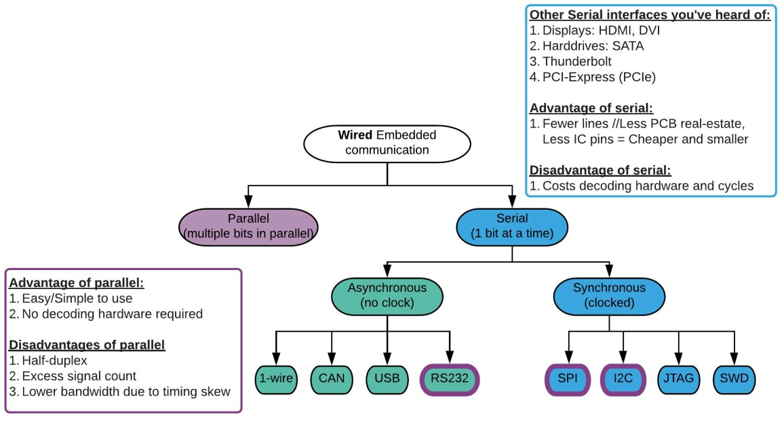
ES Wired Comms : Summary

Slide 16
References
[1] Endianness https://en.wikipedia.org/wiki/Endianness
[2] Parallel communication https://en.wikipedia.org/wiki/Parallel_communication
[3] Classiﬁcation of Embedded Systems with Applications https://www.watelectronics.com/classification-of-embedded-systems/
[4] Importance of IoT in Education https://ilmversity.com/importance-of-iot-in-education/
[5] Raspberry Pi Zero WH, built-in WiFi, presoldered headers https://www.waveshare.com/raspberry-pi-zero-wh.htm

